Slide 1
Module 2: Mechanical Separations (Chapter 29)
Lecture 2
Somak Chatterjee

Slide 2
Filtration

Slide 3
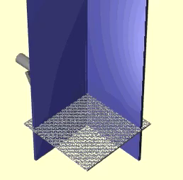
Filtration
Slurry (Waste solid and liquid)
Filter medium
Solids
Clear liquid
https://youtu.be/njOjfQdIarw

Slide 4
Filtration
Filtration is the removal of solid particles from a fluid by passing the fluid (slurry) through a filtering medium (porous) or septum on which the solids are deposited.
Industrial filtrations range from simple straining to highly complex separations.
The fluid may be a liquid or a gas; the valuable stream from the filter may be the fluid, or the solids, or both.
Sometimes it is neither, as when waste solids must be separated from waste liquid prior to disposal.

Slide 5
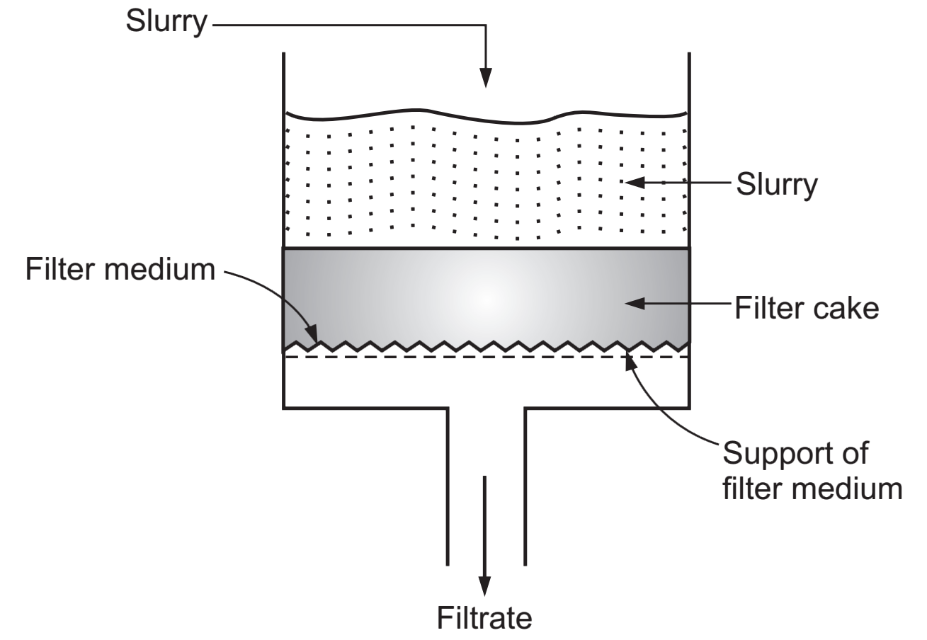
Filtration

Slide 6
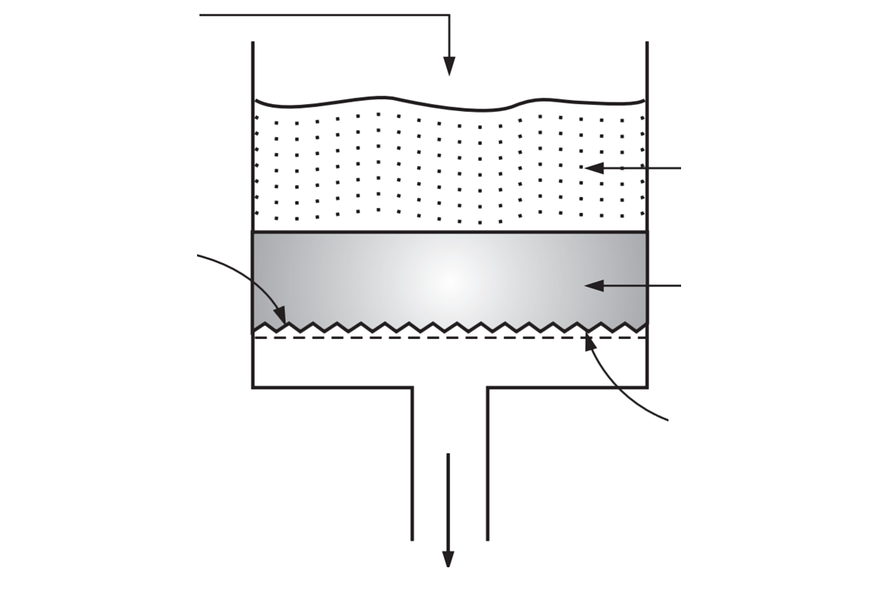
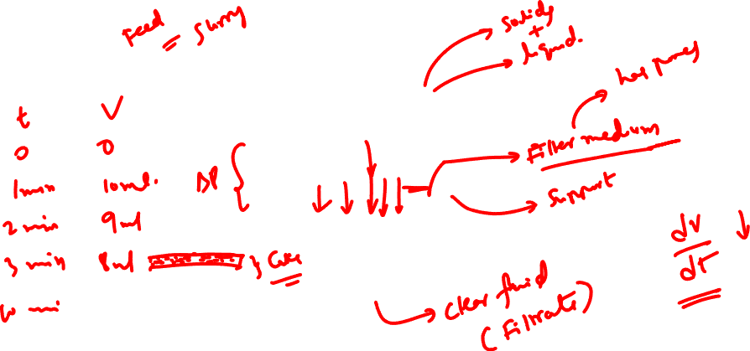
Filtration

Slide 7
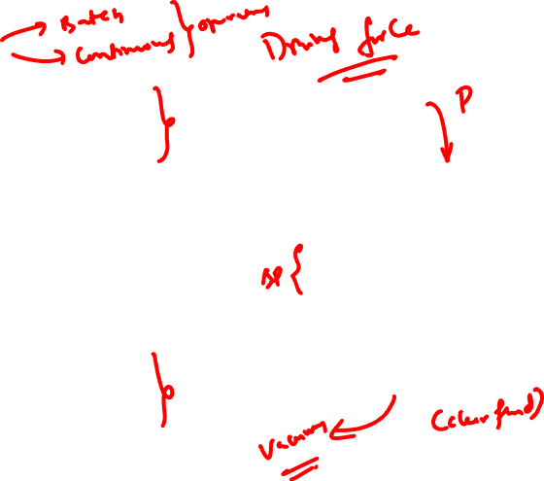
Types of filtration
Fluid flows through a filter medium by virtue of a pressure differential across the medium
Classification
  Above atmosphere pressure on upstream side of filter medium.
  A vacuum on the downstream side
In a gravity filter the filter medium can be no finer than a coarse screen or a bed of coarse particles like sand.

Slide 8
Types of filtration
Filters are divided into three main groups:
  cake filters,
  clarifying filters, and
  crossflow filters.

Slide 9
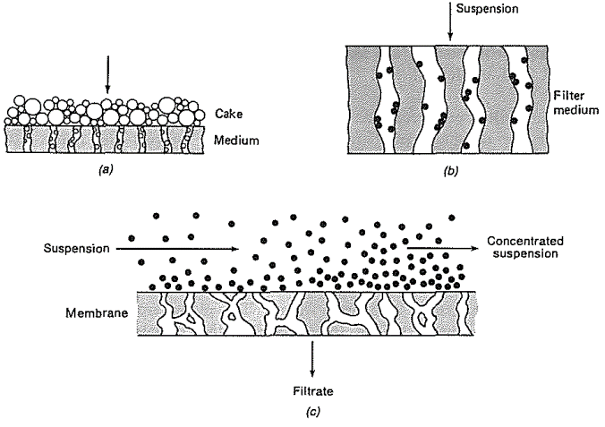
Mechanisms of filtration
Cake Filter
At the start of filtration in a cake filter some solid particles enter the pores of the medium and are immobilized, but soon others begin to collect on the septum surface.
After this brief initial period the cake of solids does the filtration, not the septum; a visible cake of appreciable thickness builds up on the surface and must be periodically removed.
Cake
Filter Medium

Slide 10
Mechanisms of filtration
Clarifying Filter (or Depth Filter)
Clarifying filter remove small amounts of solids to produce a clean gas or sparkling clear liquids such as beverages
The solid particles are trapped inside the filter medium.
Clarifying filter differ from screens in that the pores of the filter medium are much larger in diameter than the particles to be removed.
Suspension
Filter medium

Slide 11
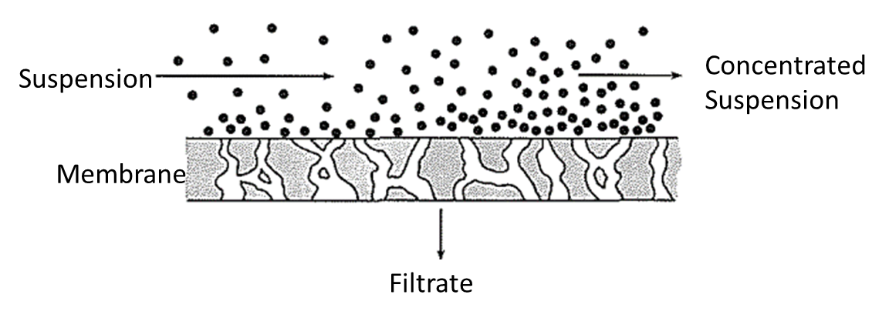
Mechanisms of filtration
Crossflow Filter
In a crossflow filter the feed suspension the feed suspension flows under pressure at a fairly high velocity across the filter medium.
A thin layer of solids may form on the surface of the medium, but high velocity keeps the layer from building up.
Filter medium is a ceramic, metal or polymer membrane with pore small enough to exclude most of the suspended particles.
Clear liquid passes through leaving concentrated suspension behind

Slide 12
Mechanisms of filtration
(a) cake filter
(b) clarifying filter
(c) Crossflow filter

Slide 13
Cake Filtration
At the start of filtration in a cake filter some solid particles enter the pores of the medium and are immobilized, but soon others begin to collect on the septum surface.
After this brief initial period the cake of solids does the filtration, not the septum; a visible cake of appreciable thickness builds up on the surface and must be periodically removed.

Slide 14
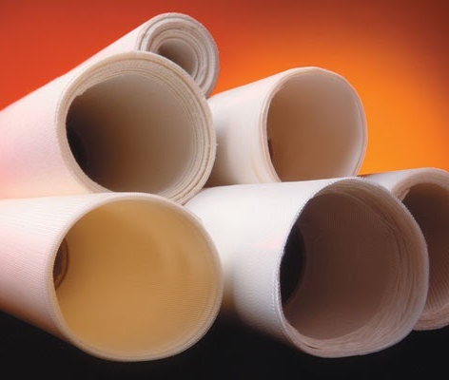
Filter media
The filter medium must meet the following requirements:
It must retain the solids to be filtered, giving a reasonably clear filtrate.
It must not plug or blind.
It must be resistant chemically and strong enough physically to withstand the process conditions.
It must permit the cake formed to discharge cleanly and completely.
It must not be prohibitively expensive.
https://www.komline.com/products/filter-fabrics/

Slide 15
Filter media
In industrial filtration a common filter medium is canvas cloth, either duck or twill weave.
Corrosive liquids require the use of other filter media, such as woolen cloth, metal cloth of monel or stainless steel, glass cloth, or paper.
Synthetic fabrics like nylon, polypropylene, and various polyesters are also highly resistant chemically.

Slide 16
Filter Aids
Filtration of slimy or very fine solids is very difficult due to the formation of a dense and impermeable cake which quickly plugs the filter medium
Porosity of the cake needs to be increased to allow the filtrate to flow through at a reasonable rate
Example of filter aid: diatomaceous silica, perlite, purified wood cellulose, or other inert porous solids
Filter aids are generally granular or fibrous solids which form highly permeable cake.
Properties: low bulk density, porous, chemically inert to the filtrate
Can be used as precoat or mixed directly with the slurry before filtration

Slide 17

PRINCIPLES OF CAKE FILTRATION
In filtration the flow resistances increase with time as the filter medium becomes clogged or a filter cake builds up
Quantities of interest are the flow rate through the filter and the pressure drop across the unit.
As time passes during filtration, either the flow rate diminishes, or the pressure drop rises.
Constant-pressure filtration: the pressure drop is held constant, and the flow rate allowed to fall with time
Constant-rate filtration: The pressure drop is progressively increased

Slide 18
PRINCIPLES OF CAKE FILTRATION
Factors affecting the rate of filtration:
  Pressure drop across the cake and the filter media
  Resistance of the cake
  Resistance of the filter media
  Area of the filtering surface
  Viscosity of the filtrate

Slide 19
PRINCIPLES OF CAKE FILTRATION
In cake filtration the liquid passes through two resistances in series:
  that of the cake and
  that of the filter medium.
The filter-medium resistance, which is the only resistance in clarifying filters, is normally important only during the early stages of cake filtration.
The cake resistance is zero at the start and increases with time as filtration proceeds.
If the cake is washed after it is filtered, both resistances are constant during the washing period and that of the filter medium is usually negligible.

Slide 20
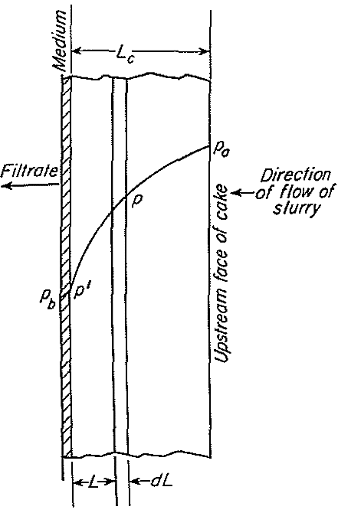
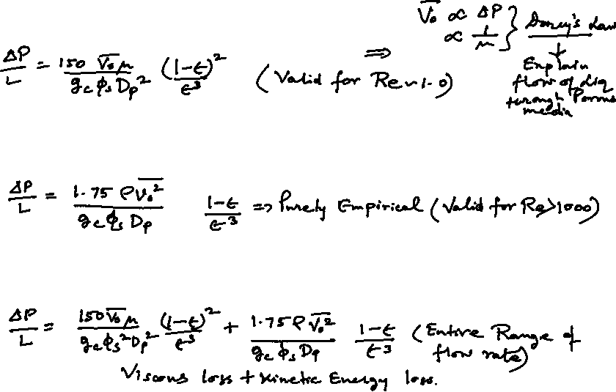
PRESSURE DROP THROUGH FILTER CAKE
Kozeny-Carman Equation
Burke Plummer Equation
Ergun Equation
Section through filter medium and cake showing pressure gradients
P = fluid pressure;
L = distance from filter medium.

Slide 21
References
Smith, J., Harriott, P., McCabe, W. (2005). Unit Operations of Chemical Engineering. Colombia: McGraw-Hill Education.
Swain, A. K., Patra, H., & Roy, G. K. (2011). Mechanical operations. Tata McGraw Hill.

